Slide 1
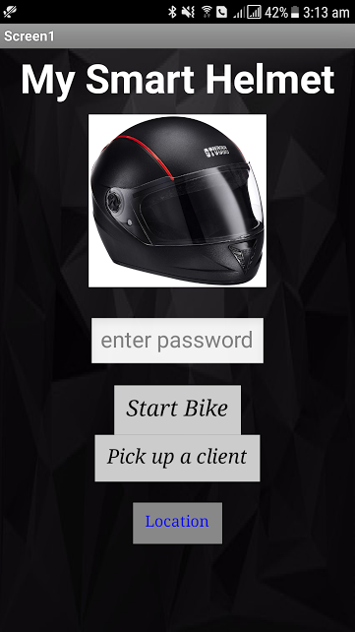
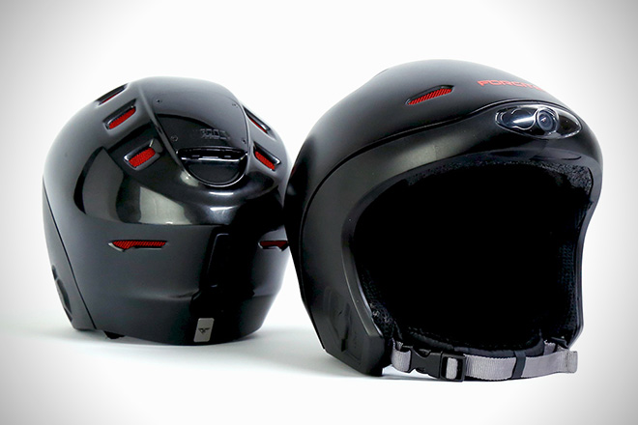
SMART HELMET
WITH SECURITY
LOCK FOR BIKE
IGNITION

Slide 2
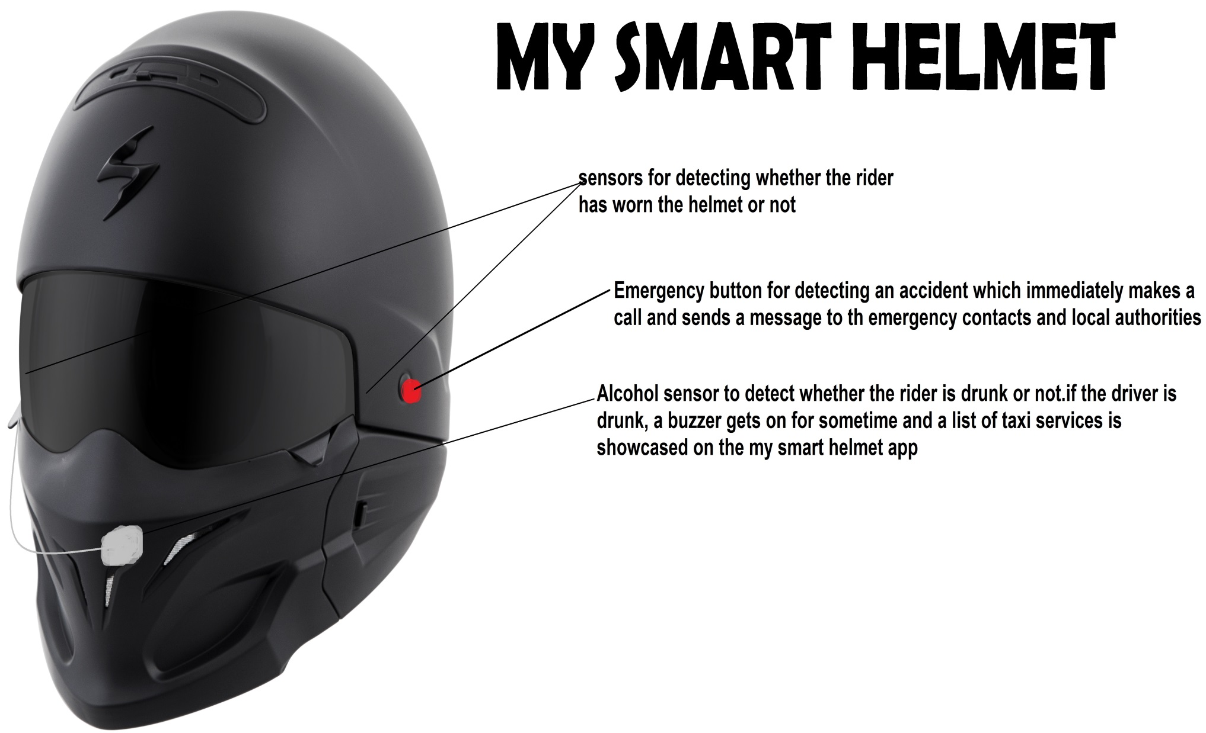
Product Design

Slide 3
Problem Assessment
This proposal aims at the security and safety of the bikers against road accidents, while also providing them with a comfortable two-wheeler experience. The helmet has an in-built circuit and software with various functions.
APPLICATIONS :
1)The circuit in helmet is designed such that the bike wont start unless the biker wears the helmet ,hasn’t consumed alcohol and a correct password is entered through the smart helmet app.
2)If alcohol is detected, the buzzer gets on for sometime and a list of taxi services is showcased on the smart helmet app.
3)In case of accident, the GPS system installed with the smart helmet will globally locate the biker and an immediate call and message will be sent to the emergency contacts and the local authorities.
4)The password detector system can be used to automate the ignition locking process, so the user need not carry the ignition lock keys along with him.

Slide 4
Components required:
8051 microcontroller
Alcohol sensor
Connecting wires
Relay
Power supply
LED
IR sensor
Crash sensor
GPS module
GSM module
Bluetooth module
Raspberry Pi
Motor
Ignition switch

